Slide 1

Presentation on HOUSING PRICE PREDICTION
Submitted by:
P Naga Suvarchala
Data Science Intern
Flip Robo Technologies

Slide 2
ACKNOWLEDGMENT
I would like to express my deep sense of gratitude to my SME (Subject Matter Expert) Miss. Khushboo Garg as well as Flip Robo Technologies who gave me the golden opportunity to do this data Science project on Housing: Price Prediction, which also helped me in doing lots of research and I came to know about so many new things.
I am very much thankful to Dr. Deepika, Trainer (DataTrained), for her valuable guidance, keen interest, and encouragement at various stages of my training period which eventually helped me a lot in doing this project.

Slide 3
INTRODUCTION
Houses are one of the necessary need of every person around the globe and therefore housing and real estate market is one of the markets which is one of the major contributors in the world’s economy.
Data science comes as a very important tool to solve problems in the domain to help the companies increase their overall revenue, profits, improving their marketing strategies and focusing on changing trends in house sales and purchases. Predictive modelling, Market mix modelling, recommendation systems are some of the machine learning techniques used for achieving the business goals for housing companies.
This model will help to determine the price of houses with the available independent variables. This model will then be used by the management to understand how exactly the prices vary with the variables. They can accordingly manipulate the strategy of the firm and concentrate on areas that will yield high returns.

Slide 4
Problem Statement
A US-based housing company named Surprise Housing has decided to enter the Australian market. The company uses data analytics to purchase houses at a price below their actual values and flip them at a higher price. For the same purpose, the company has collected a data set from the sale of houses in Australia.
The company is looking at prospective properties to buy houses to enter the market. We are required to build a model using Machine Learning in order to predict the actual value of the prospective properties and decide whether to invest in them or not. For this company wants to know:
• Which variables are important to predict the price of variable?
• How do these variables describe the price of the house

Slide 5
Objectives of the study
Study & Exploratory Data Analysis (EDA) of House Price Prediction in dataset
To perform tasks of Summary Statistics & Correlation factor of the problem dataset.
To perform data pre-processing of the dataset and perform Mathematical/ Analytical Modeling of the Problem in order to train the model.
Formulate Model/s Development, Evaluation and Testing of Identified Approaches.
Visualizations , Interpretation of the Results and finalizing the model.

Slide 6
Software Requirements and Tools Used
Software Tools used:
Programming language: Python
Distribution: Anaconda Navigator
Browser-based language shell: Jupyter Notebook
Libraries/Packages Used:
Pandas
Numpy
Matplotlib
Seaborn
Scipy.stats
Sklearn

Slide 7
Literature Review
Nehal N Ghosalkar et. Al., describes that the real estate market is a standout amongst the most focused regarding pricing and keeps fluctuating. It is one of the prime fields to apply the ideas of machine learning on how to enhance and foresee the costs with high accuracy. Three factors influence the price of a house which include physical conditions, concepts, and location. The current framework includes estimating the price of houses without any expectations of market prices and cost increments. The objective of the paper is the prediction of residential prices for the customers considering their financial plans and needs. By breaking down past market patterns and value ranges, and coming advancements future costs will be anticipated. This examination means to predict house prices in the city with Linear Regression. It will help clients to put resources into a bequest without moving toward a broker.

Slide 8
DATA ANALYSIS - MODEL BUILDING FLOWCHART
Import Dependencies or Libraries
Data Collection
Data pre-processing
Encoding
EDA and Visualization
Check for Null Values
Check for correlation
Check for Outliers/Skewness
Proceed for Model building
Saving the Final Model
Hyper Parameter Tuning
R2 Score, Cross Validation Score, MSE, RMSE, MAE

Slide 9
Mathematical/ Analytical Modelling of the Problem
The provided dataset is in CSV format. We will begin with loading the dataset and reading the dataset from the CSV file using the read_csv() function from the Pandas Python package. Next, we will perform Non-Graphical Exploratory Data Analysis (EDA) such as checking the data types and missing values using pandas info() function, Then, we will get statistical information about the numeric columns in our dataset using pandas.DataFrame.describe() method. After that, we will move on to perform graphical EDA to get more insights from our dataset and how the feature attribute affects the target attribute.
Next, we will perform data pre-processing to treat the missing values, dropping columns not helpful for our model prediction, removing outliers if there is, removing skewness, etc. Further, we will build a full pipeline for our model prediction.
Since we have to predict house prices in this dataset therefore we will be building and training a few regression-based models to predict the price of the houses.

Slide 10
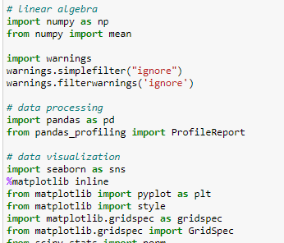
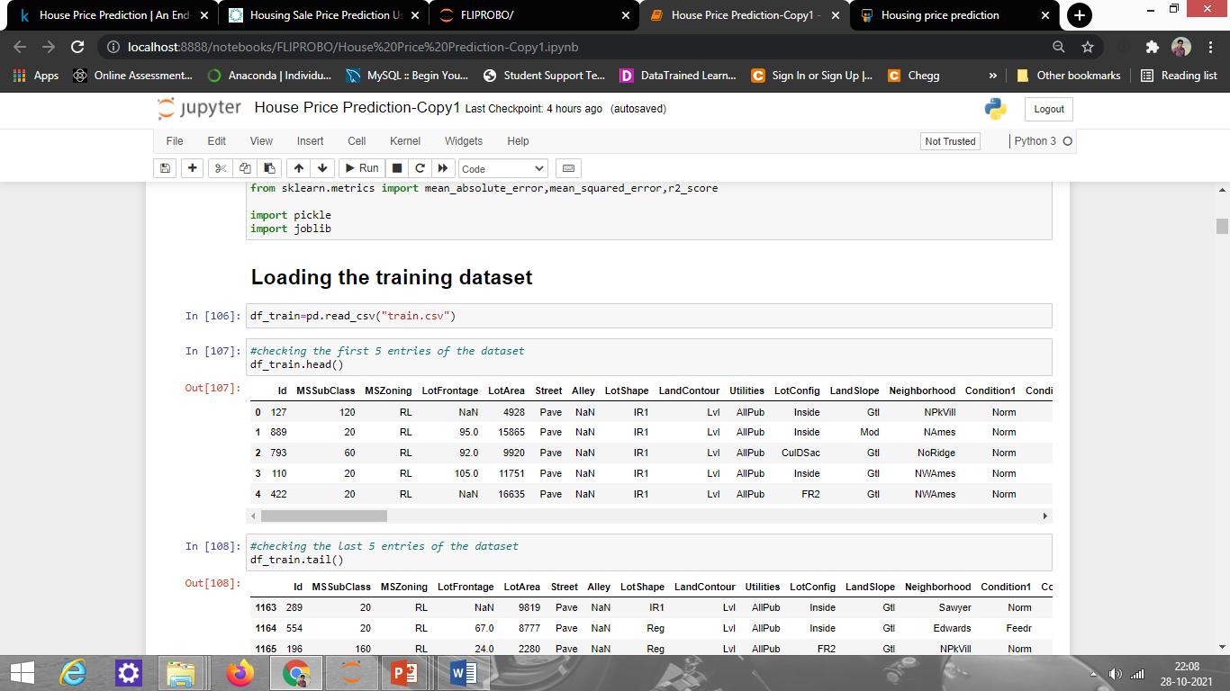
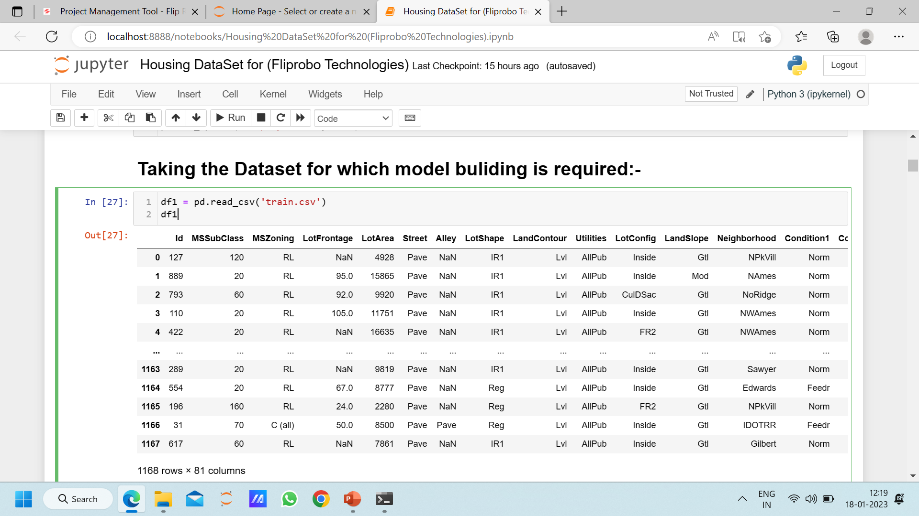
Working with the Dataset
Importing Libraries:
Loading the dataset:

Slide 11
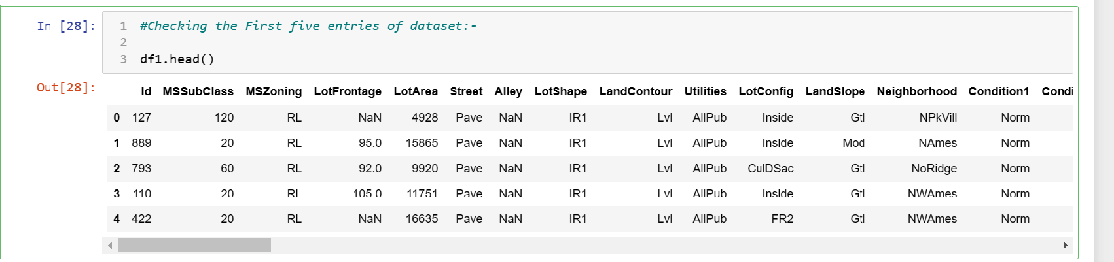
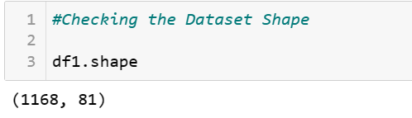
Data Sources and their formats
Observation:
Data has 1168 rows and 81 columns

Slide 12
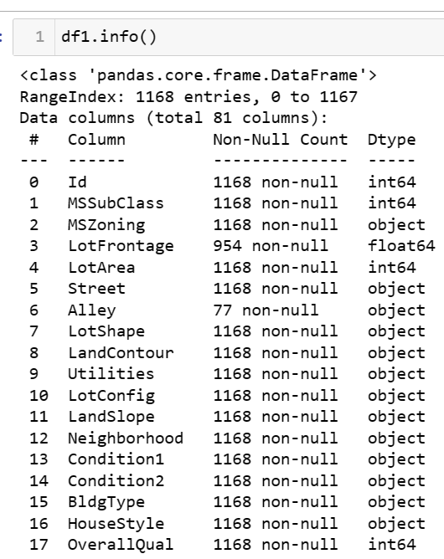
Data type Information:
Observations:
There are 38 numerical columns and 43 categorical columns
Some columns should be an object such as mssubclass, overallqual, etc. but are in numerical format.

Slide 13
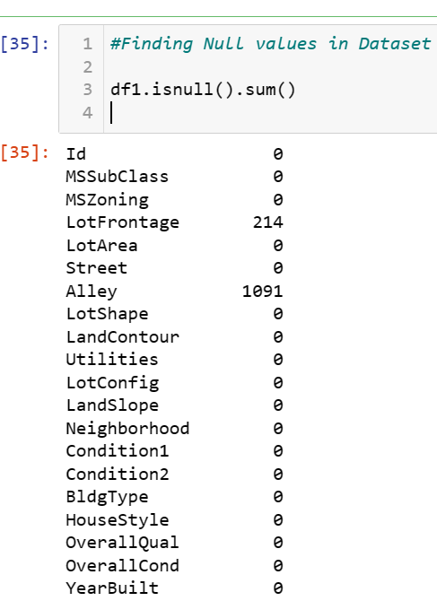
Missing Values In dataset
Observation:
There are many missing values that we have to handle before model training. I am treating some columns that have numerous missing values by replacing them with None for categorical columns, and numerical columns, I am replacing them with 0 only when if they have a lot of missing values.
And for the columns having fewer missing values, I am replacing them with mode for categorical columns, and for numerical I am replacing them with mean.

Slide 14
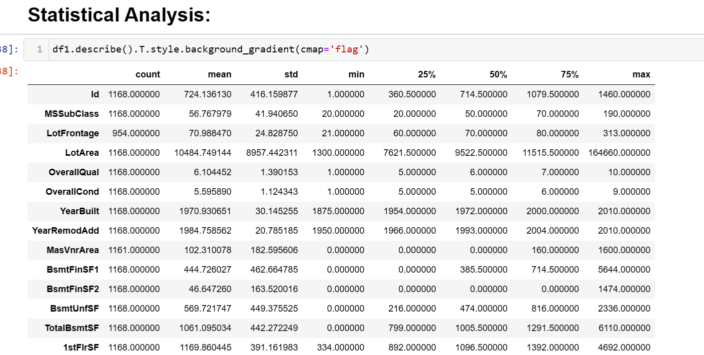
Statistical summary of the data:
From this summary, we can see all the numeric value details and also see the spread of the data.
Also, the count is not the same for all the columns indicating that there are missing values present in the dataset.

Slide 15
DATA PRE-PROCESSING
Filling /Treating Missing values: We have defined a function to treat the missing values present
Feature Engineering: we have defined a class to create more features so our machine learning models performs well.
Feature Transformation: We are using LabelEncoder to encode the categorical features
Handling Multi-collinearity: With the help of heatmap & correlation bar graph we were able to understand the feature vs target relativity and insights on multi-collinearity amongst the feature columns.
Removing Outliers: with the help of percentile method as we can replace the outliers with percentile value and don't lose any data.
Removing Skewness of continuous data (with threshold value -1 to +1) using power_transform function from sklearn.preprocessing.
Feature Scaling: we are using StandardScaler to scale all high values to same scale

Slide 16
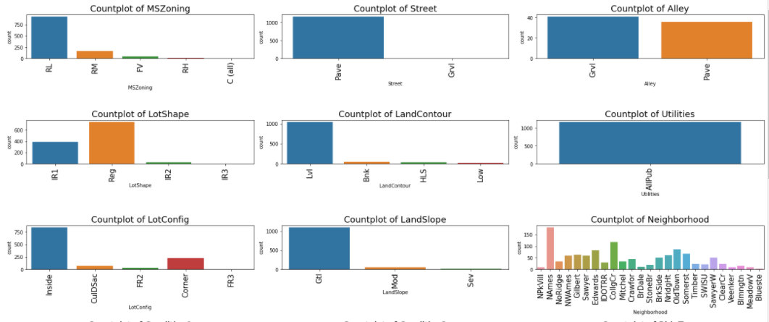
Univariate Analysis
EXPLORATORY DATA ANALYSIS (EDA)

Slide 17
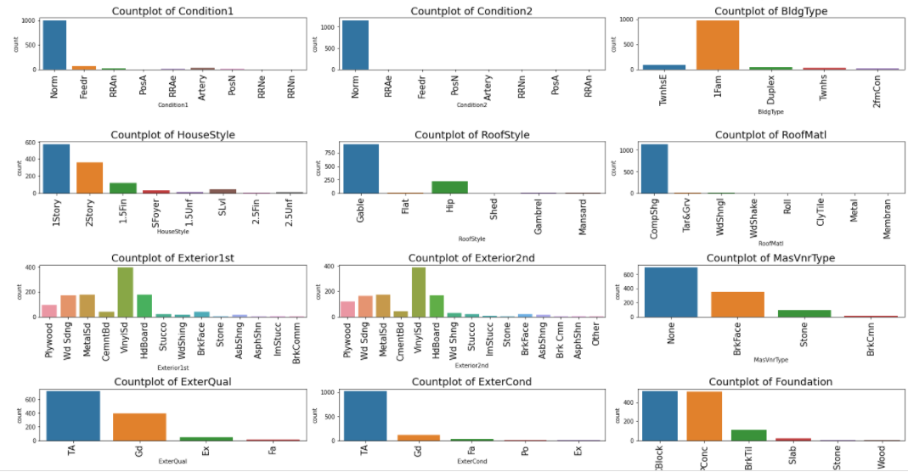
Univariate Analysis

Slide 18
Observations
From MSZoning plot, we can see that most of the people like houses in the zone having Residential Low Density
From Street plot, we can see that most of the people like to have property that have paved roads.
From Alley plot, we can see that mostly people like to have gravel alley.
From LotShape plot, we can see that mostly people like regular followed by slightly irregular shaped property.
From LandContour plot,we can see that mostly people preferred property having Flatness Near Flat/Level.
From LotConfig plot, we can see that mostly people like inside lot and around 20% of people like corner lot
From LandSlope plot, we can see that the majority of people preferred property having Gentle slope.
From Neighborhood plot, we can see that mostly people preferred North Ames followed by College Creek as the Physical locations within Ames city limits.
From Condition1 & Condition2 plot, we can see that mostly people preferred normal Proximity to various conditions.
From BldgType plot, we see that people preferred single-family detached as the Type of dwelling.
From HouseStyle plot, we see that mostly people selected one story, and two story houses.
From RoofStyle plot, we can see that mostly people like Gable type of roof.
From RoofMatl plot, we see that mostly people preffered clay or tile roof material.

Slide 19
Observations
From Exterior1st and Exterior2nd plot, we see that moslty people preferred Vinyl Siding and Hard board as the exterior covering on houses.
From MasVnrType plot, we can say that people like None.
From ExterQual and ExterCond plot, it is see that mostly people are happy with Average quality material on the exterior of the houses.
From Foundation plot, we can say moslty people preferred Cinder Block and Poured Contrete type of foundation.
From BsmntQual and BsmtCond plot, we see that people like Good (90-99 inches) and Typical (80-89 inches) kind of basement.
From BsmtExposure plot, it can be see that people like No Exposure type of garden level walls.
From BsmtFinType1 plot, we can say moslty people like Good Living Quarters followed by unfinished type of basement finished area.
From BsmtFinType2 plot, we can say people like good living quarters with basement finished area.
From CenteralAir plot,we can say moslty people like to have central air.
From Electrical system plot, we can say people like Standard Circuit Breakers & Romex(SBrkr).
From Countplot of Garage type, we can say people love to have houses that have garage attached to home.

Slide 20
Observations:
From Heating plot, we can see that people preferred Gas forced warm air furnace.
From HeatingQC plot, we can see that people preferred houses with excellent, followed by typical/average type of heating quality and condition.
From Functional plot, we can see that mostly people preferred houses with Typical Functionality.
From KitchenQual plot, we can see that mostly people preferred houses with Typical/Average type of kitchen quality followed by Good and excellent kitchen quality.
From FireplaceQual plot, we can see that majority of people preferred house with Average i.e., Prefabricated Fireplace in main living area or Masonry Fireplace in basement.
From GarageFinish plot, we can see that mostly people preferred houses having unfinished or roughly finished garage.
From GarageQual and GarageCond plot, it is see that people mostly like houses with Typical/Average quality and condition garage.
From PavedDrive plot, it is seen that people preferred houses with paved driveway.
From PoolQC plot, it is seen that people like houses with good qualityb pool.
From Fence plot, it is seen that mostly people like Minimum Privacy quality fence.
From MisFeature plot, we can see that people preferred houses with shed.
From Salestype plot, we can say people love to have a home that have Warranty Deed- Conventional type of sale.
From salesconditon plot, we can say people love to have a home that have normal sale.

Slide 21
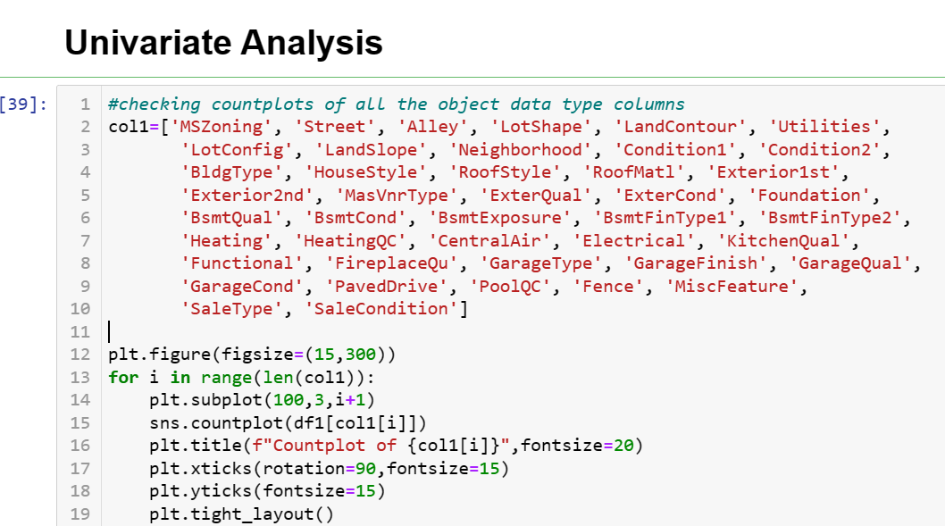
EDA
Distribution of numerical columns
This code will help us to plot all the numerical column one by one so these is no need to write separate code for all of them

Slide 22
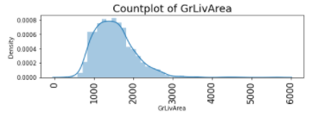
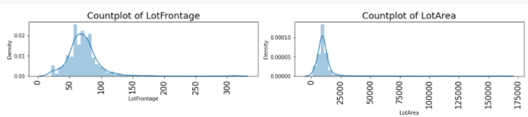
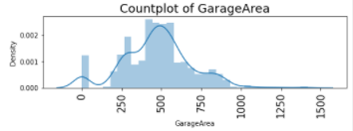
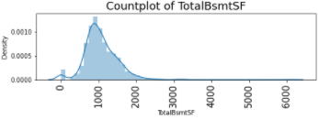
Distribution Of Numerical Column
From LotFrontage countplot, we can say that majority of people preferred linear feet of street between 60-80.
From LotArea countplot, we can see that mostly people like lot size between 0-25000sq.ft.
From Total square feet of basement area(TotalBsmtSF) plot, we can say the value is mostly in between 100-2000 and majority of people have the basement of size 800-1100 square feet.
From GrLivArea plot, we can say mostly people have above grade living area square feet between 1200-1900.
From GarageArea plot, we can say mostly people like to have garage having area between 450-600 sq. ft.
From saleprice plot, we can say majority of people like to buy houses having price between 140000-190000 and also the data is right skewed.

Slide 23
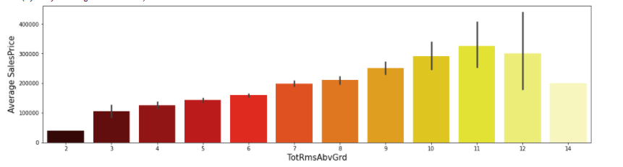
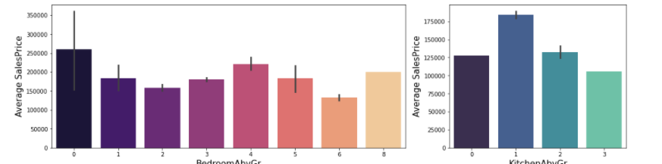
BIVARIATE ANALYSIS
From TotRmsAbvGrd vs SalePrice plot, we see that as total rooms Above Ground is increasing, the average price is also increasing until 11th room and the price starts to decrease.
From Bedroom ABove Ground Vs Saleprice plot, we can see that for the 0,4,8 Bedroom number, price is high and price is very less for 6 and 2 bedroom number.
From Kitchen Above Ground Vs saleprice plot, we can see that as the no. of kitchen is increasing, the price is decreasing indicating mostly people take one kitchen house only.

Slide 24
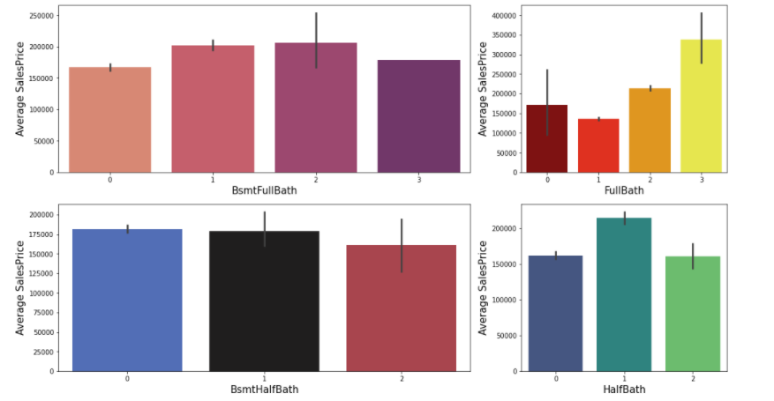
BIVARIATE ANALYSIS
In Basement full bathroom & half bathrooms vs saleprice plot, we see that as the bathroom size increasing, the price is also increasing.

Slide 25
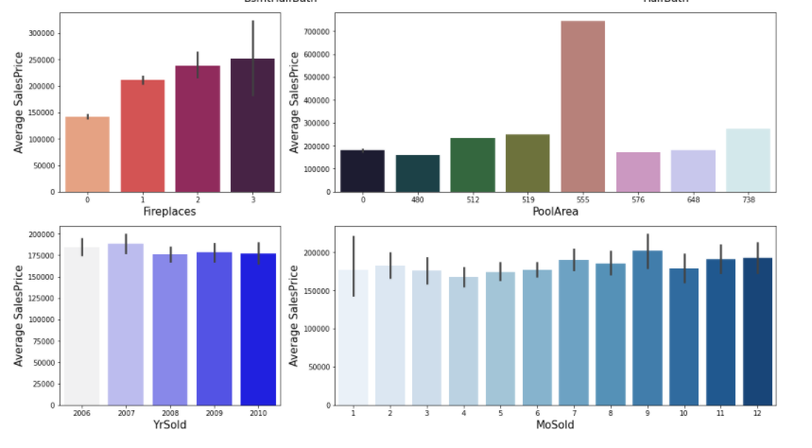
BIVARIATE ANALYSIS
From Fireplaces vs saleprice plot, we see that as the fireplaces increasing, the sale price is also increasing.
From the PoolArea vs saleprice plot, we see that the pool having area 555 has the highest sale price.
From YrSold vs saleprice plot, we can see that sale price was high in 2006 and it decreased in 2008-10.
From MoSold vs saleprice plot, we can see that most of the people who sold their home in the month of september got high price and those who sold their home in April month got less price.

Slide 26
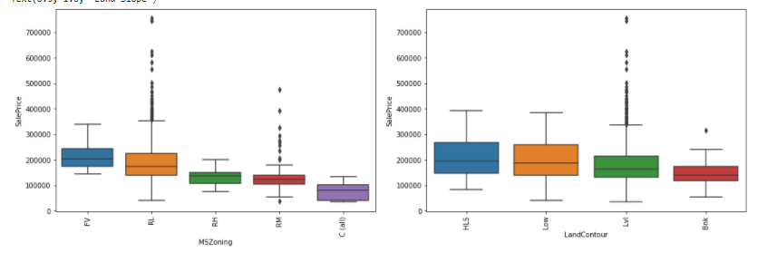
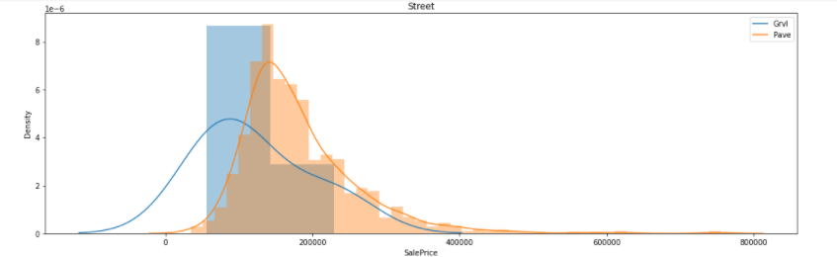
BIVARIATE ANALYSIS
From MSZoning vs Saleprice plot, we see that Floating Village Residential zone (FV) is having higher sale price of around 2 lakhs While Commercial Zones are having the lowest sale prices and we see a variation in sale prices in different zones which makes it an important feature for our prediction.
From LandCountour vs saleprice plot, we see that if the house has significant slope on both sides (HLS) or have depression (Low),sale prices is more. For nearly flat/level and banked slopes,Sale price is less.
From the 3rd plot, we see that For flat stones or bricks access streets,Price is higher and majority of houses with gravel street have price around 2 lakhs but as there is very less data for gravel street type this feature is not that important for prediction.

Slide 27
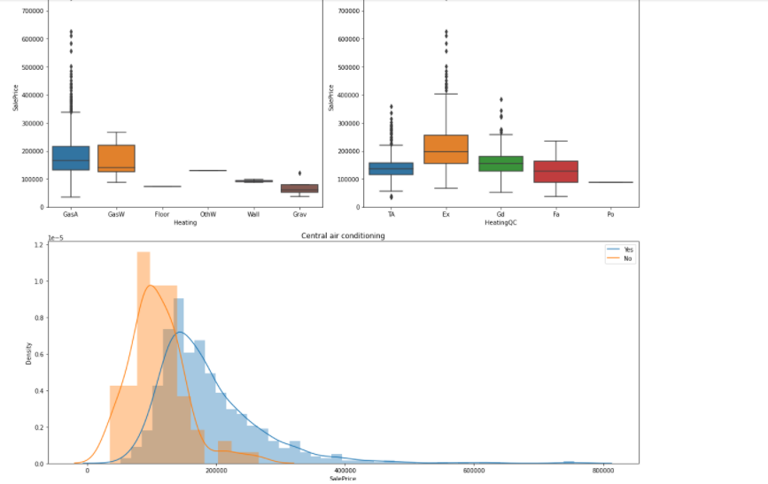
BIVARIATE ANALYSIS
From plot-1, we can see that houses having GasW(Gas hot water or steam heat) and GasA(Gas forced warm air furnace) type of heating have high sale prices.
From plot-2, we see that houses with excellent(Ex) heating quality and condition costs more.
From plot-3, we see that houses having Central AC have higher price that the ones that don't have Central AC.

Slide 28
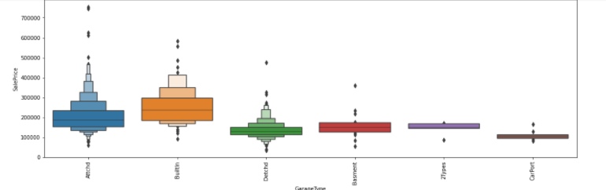
BIVARIATE ANALYSIS
we can see that houses with built in or attached garages tend to have the highest prices, while those with more than one type of garage or a car port tend to have the lowest prices.

Slide 29
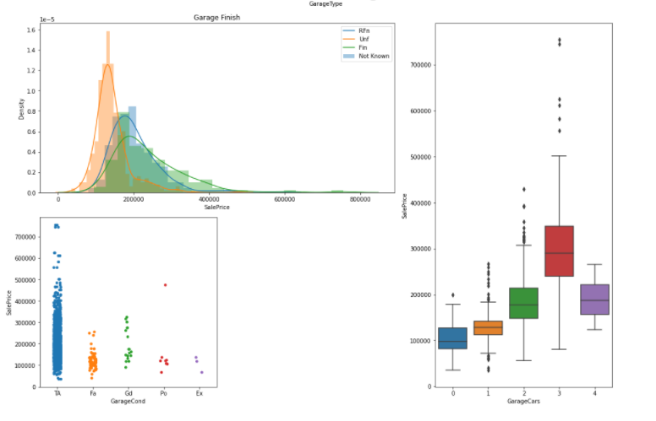
BIVARIATE ANALYSIS
From plot-1, we see that roughly finished garages account for higher sale price than finished and unfinished ones, while the properties which don't have a garage have the lowest price.
From Garagecond vs saleprice plot, we see that houses with typical/average condition garages account for higher sale price than garages with excellent or poor condtion.
From GarageCars vs saleprice plot, we see that sale price is higher with high number of GarageCars which refers to size of garage in car capacity.

Slide 30
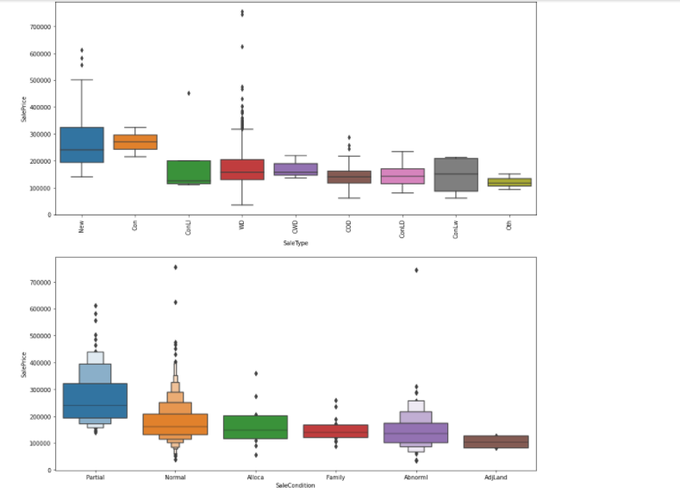
BIVARIATE ANALYSIS
OBSERVATIONS
1-Sale Type-Most of the properties are on warranty deed sale. The manor in which the house is sold appears to have different price ranges
2-Sale Condition-if the house to be sold is in partial or normal condition,the price will definitely be higher than the rest of the conditions.
bases on the analysis of the above categorical features,we can conclude that the following features are important in predicting the sale price.
1-MSSubclass and mszoning
2-all the quality features,as the houses with average,good,excellent quality features will have higher sale price
3-Fireplaces and garage cars,more the no. , higher the sale price
4-we also saw variation in absement exposure
5-And lastly sale type and sale condition are also one of the important features

Slide 31
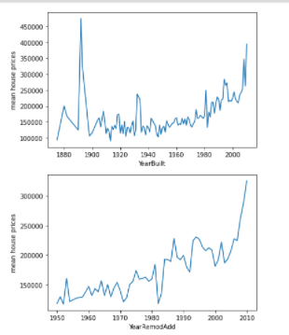
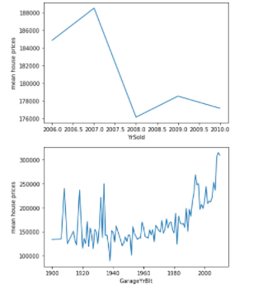
BIVARIATE ANALYSIS
OBSERVATIONS
From these plots, we can conclude that-
the houses and garage which were built between 1910-1950 have less sale price than the newer ones and after that with every year,house price increased
but if i notice Year Sold feature the price fell down with each year which is strange.

Slide 32
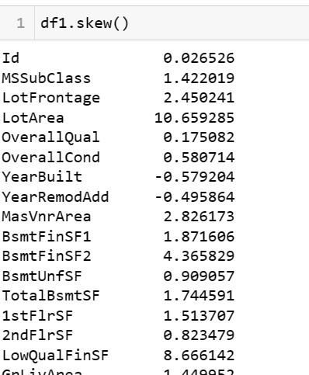
CHECKING SKEWNESS
There is a lot of skewness in our dataset as we can see and the skewness is only counted for numerical column not for categorical columns.
So we need to remove the skewness as we know if my data has greater then 0.5 value for skewness or -0.5 then the column is consider to be as a skewed column

Slide 33
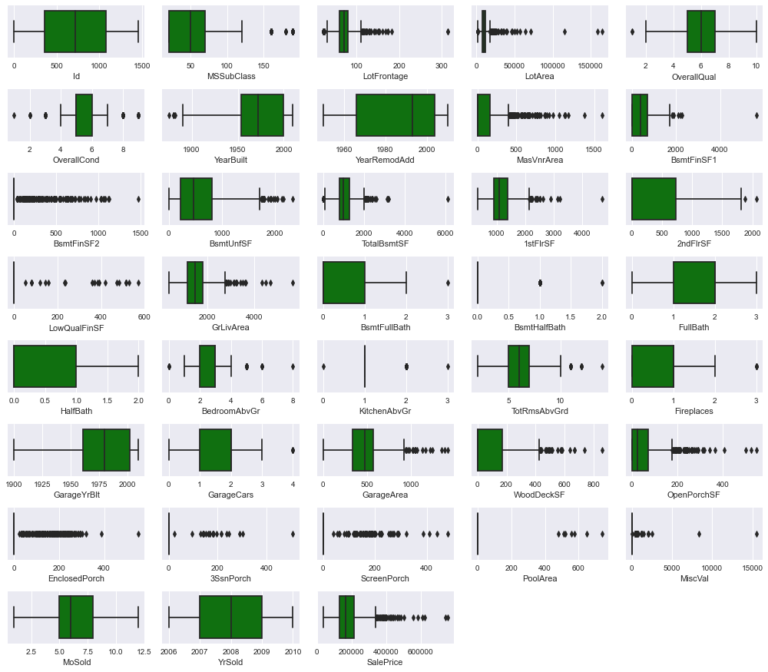
CHECKING OUTLIERS
As we can see there are lot of outliers.
As I have used box plot for outlier detection box plot is a very good method for detecting outliers as it show the value in percentile.

Slide 34
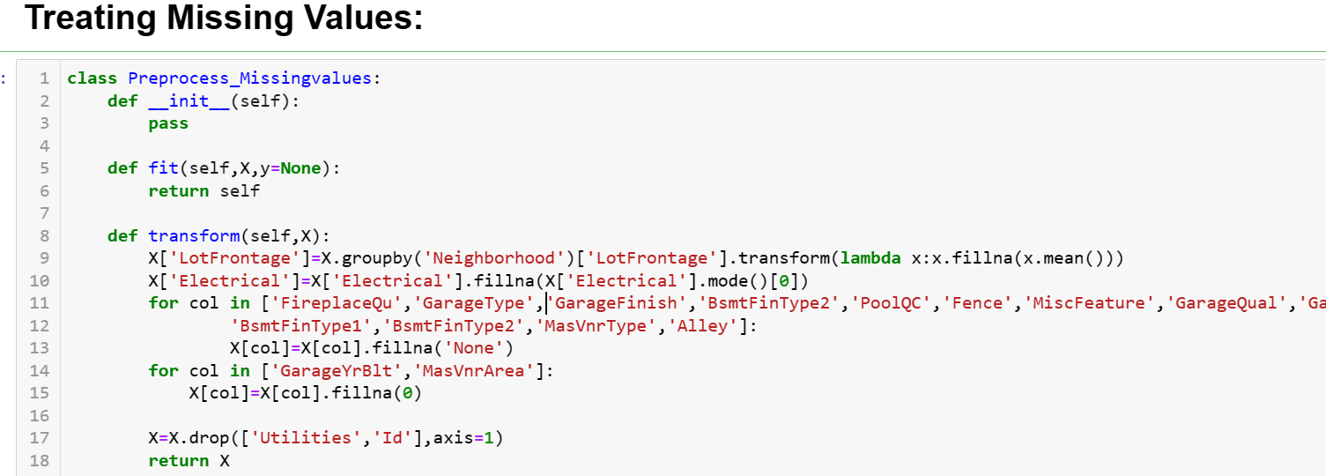
BUILDING PIPELINE
we are defining a class to treat the missing value that are from categorical column or from numerical column and we are also droping some columns that are not useful like 'id' which only represent the unique ids.

Slide 35
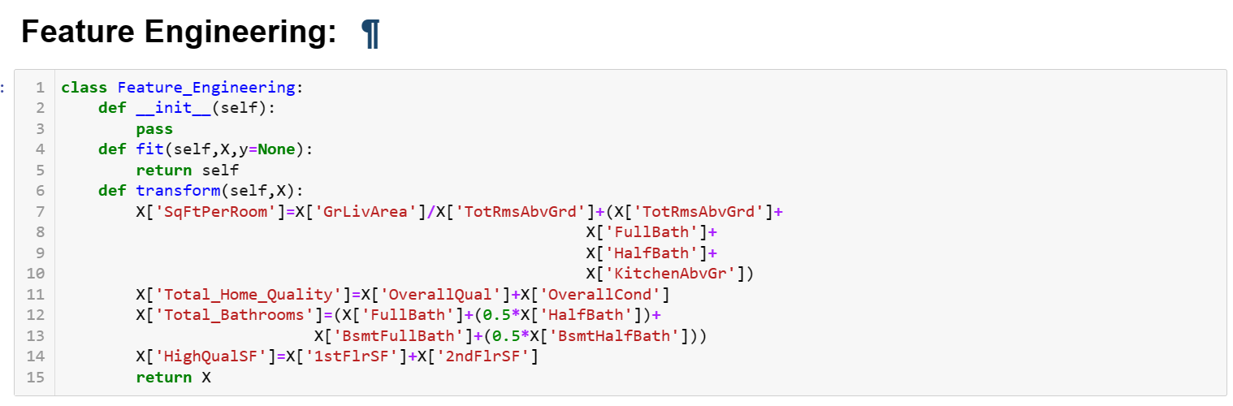
PIPELINE STEP
we have defined a class to create more features so our machine learning models performs well. Feature engineering is one of the most important method in ML. As there are many bathrooms like some are fullbath while some are halfbath so we are creating a total bathroom feature and also creating the sqftperroom.

Slide 36
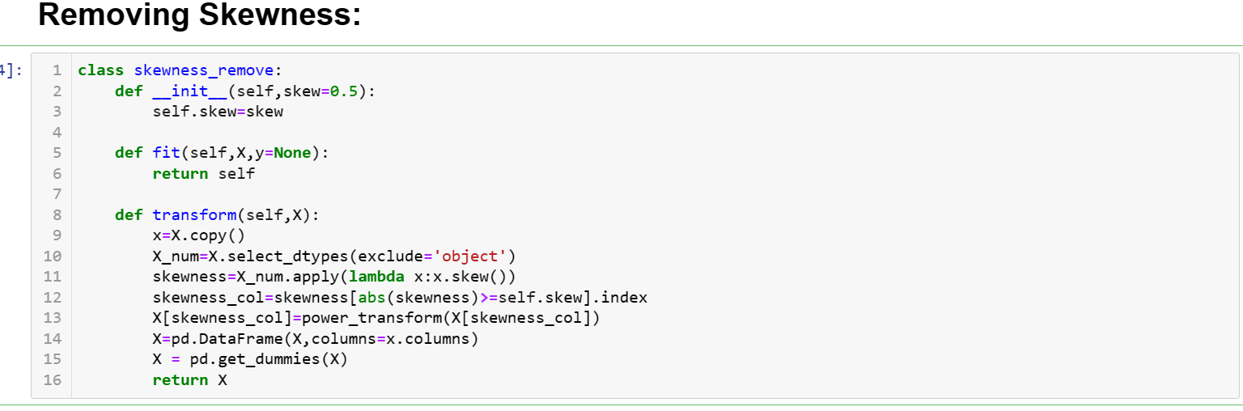
PIPELINE STEPS
To remove skewness we have created a class where if any column is having skewness more than -/+0.5, it will remove the skewness from that column.

Slide 37
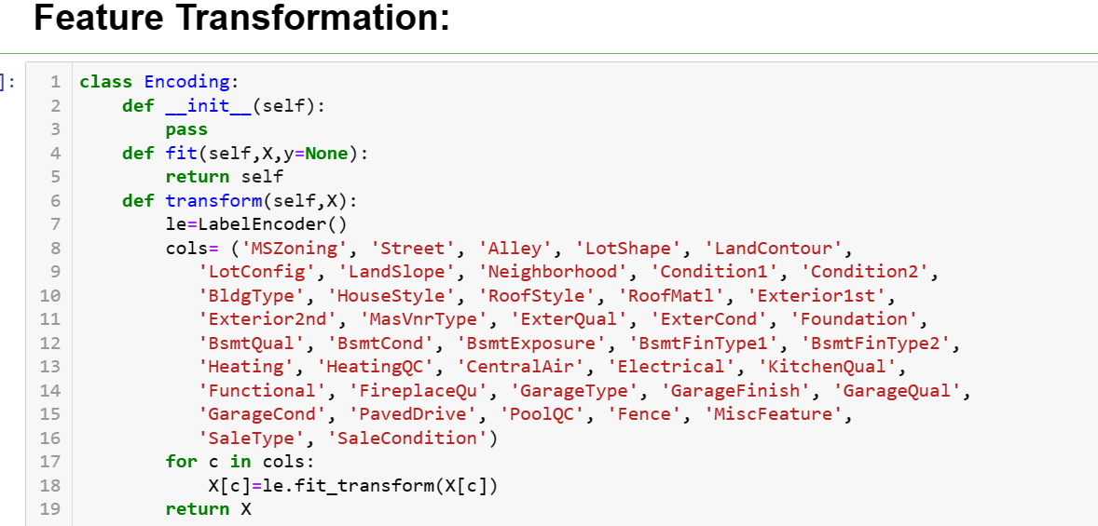
PIPELINE STEP
Here i am using Label Encoder because we already have many columns if i will use one hot i will increase the dimension of the data which will create the problem for machine learning model to understand things that’s why i am using label encoder

Slide 38
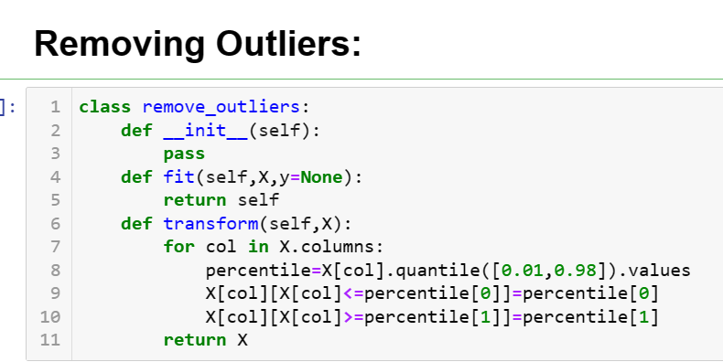
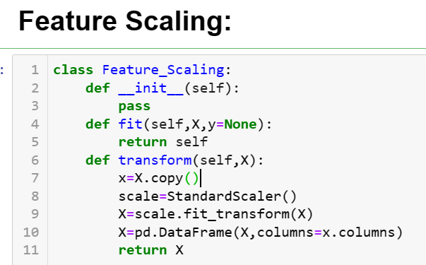
PIPELINE STEP
As we have lot of outliers so we have to remove them hence i am using here percentile method to remove outliers. Somethimes what happen is that if we use zscore and IQR method,it deletes all the data, but with the help of percentile method we can replace the outliers with percentile value and we don't lose the data as well.
using StandardScaler to scale all large value in same scale

Slide 39
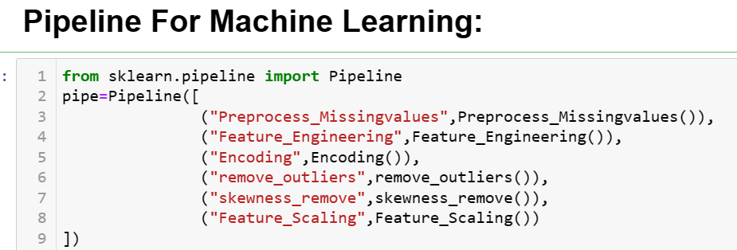
FINAL PIPELINE
Here I have called all the classes that I have defined so if any new data is coming I will pass it through pipeline and it will do all the steps
*Pre-processing
*Feature Engineering
*Encoding
*Remove Outliers
*Remove Skewness
*Feature Scaling

Slide 40
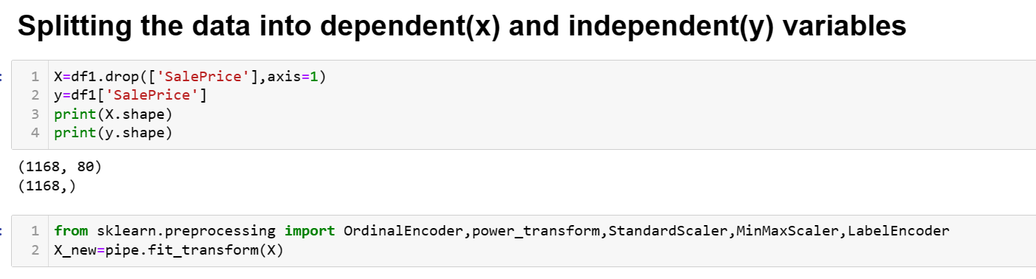
PASSING DATA THROUGH PIPELINE
Here I am passing my data through pipeline so my raw data will will be prepared for machine learning.

Slide 41
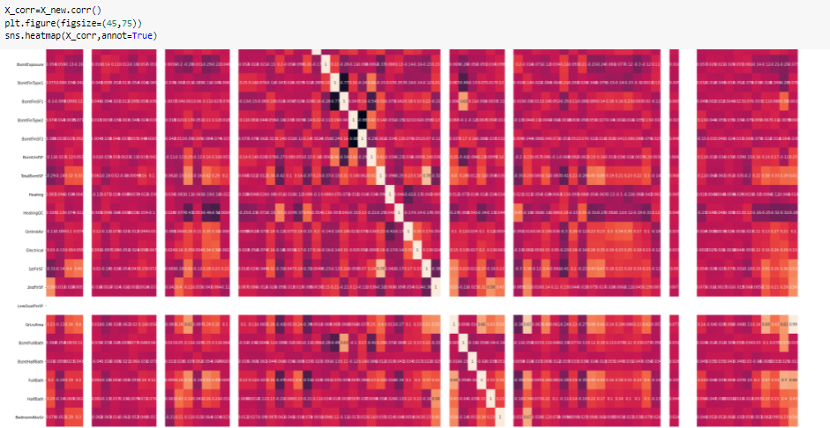
CHECKING MULTICOLLINEARITY

Slide 42
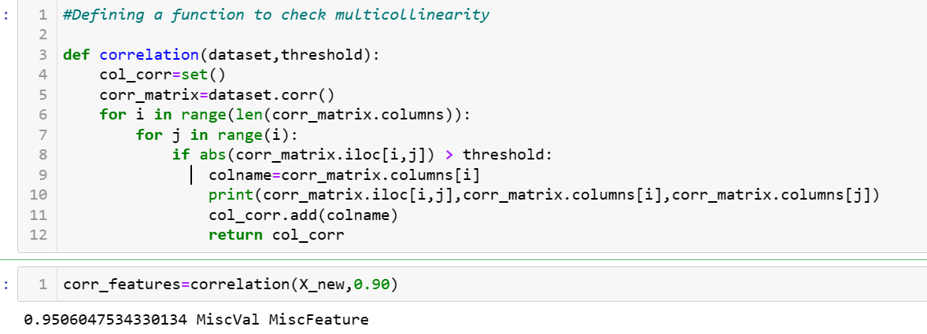

MULTICOLLINEARITY
As the previous heatmap graph was very big so I cant find multicollinearity through that so this code will help me where I have set the threshold for 90 %
So it is telling me that there are total 4 columns that are highly correlated to each other so I am dropping two column so there will we no multicollinearity in the data

Slide 43
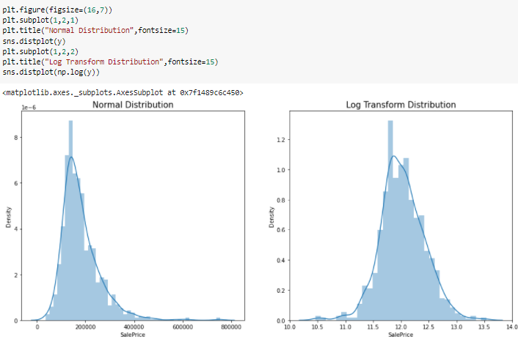
TARGET COLUMN TRANSFORMATION
we can see that the target column is right skewed and we can transform our target column and at the time of prediction we will inverse it so there will be no effect of it on our prediction

Slide 44
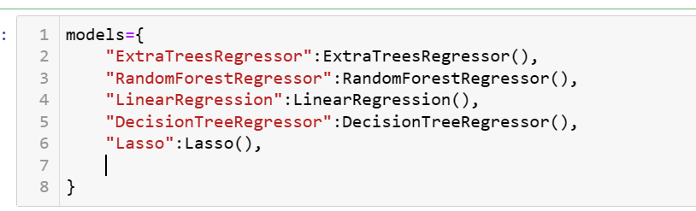
Splitting data for model building using train test split:
Here I am taking 5 models for prediction

Slide 45
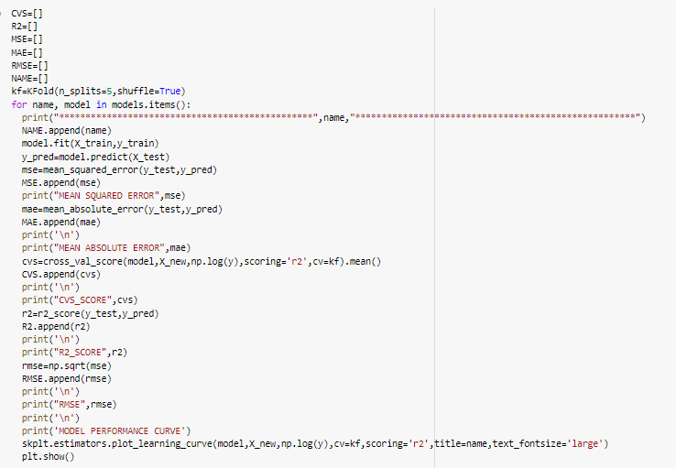
TRAINING MODELS
Here I have written this code which will return me all the metrics and all the model score with cross val score
And for good performance I am using KFOLD cross validation for this data
And this code will also return me the learning curve for all the model so even I can check if my model is underfitted or overfitted

Slide 46
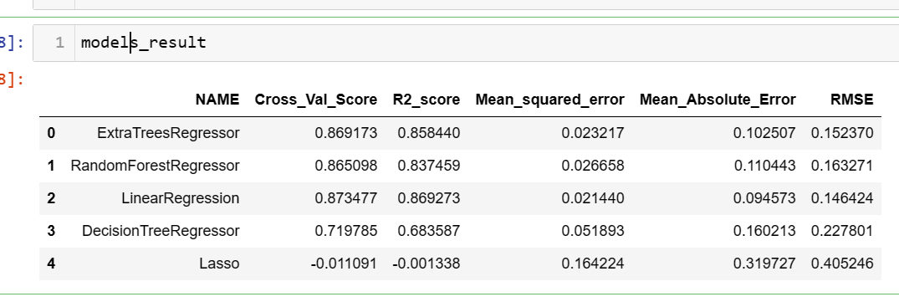
RESULTS OF MODELS
From this result I can see which model is performing well.

Slide 47
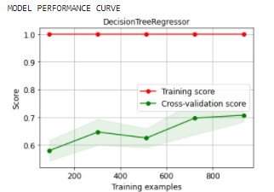
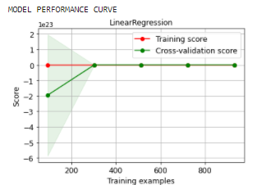
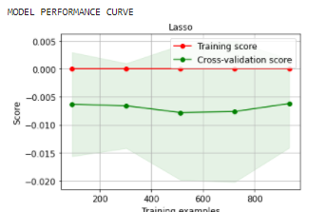
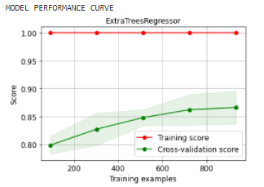
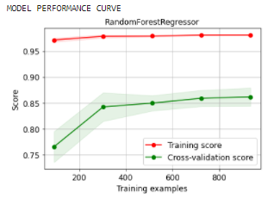
MODEL LEARNING CURVES
From the graphs above we can easily see like lasso are underfitter . They are showing a good score like cv score mse, mae . But when we see the model learning curve it is not performing well.
We are going to proceed with Linear Regressor as our best model because it is performing good and also have a good Learning curve

Slide 48
Key Metrics for success in solving problem under consideration
To find out the best performing model following metrics are used:
R2 Score: It is used to check the model performance score between 0.0 to 1.0
Mean Squared Error: The mean squared error of a model concerning a test set is the mean of the squared prediction errors over all instances in the test set.
Root Mean Squared Error: It is the root of mean squared error.
Mean Absolute Error: It is the average of absolute errors for a group of predictions and observations as a measurement of the magnitude of errors for the entire group.

Slide 49
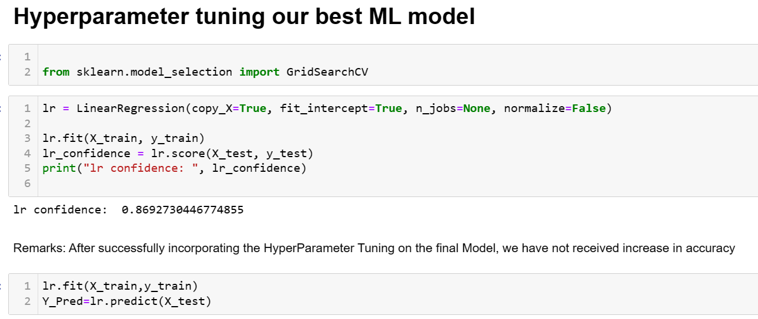
HYPERPARAMETER TUNING
Remarks: After successfully incorporating the HyperParameter Tuning on the final Model, we have received the accuracy score of 86%.

Slide 50
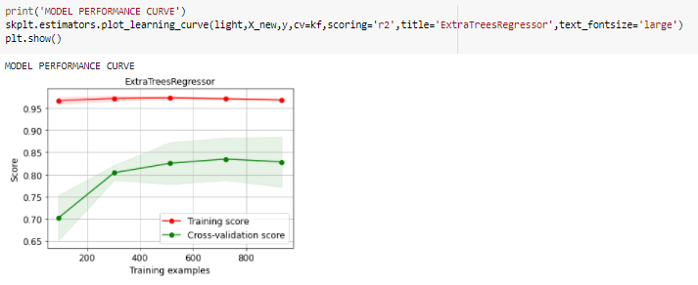

FINAL MODEL METRICS
This is the final model learning curve and we can see all the performance metrics of final model after hyperparameter tuning

Slide 51

PREDICTION ON TEST DATA
Here, we can see the sale price of house predicted by the final model.

Slide 52
CONCLUSION
:
The Linear Regressor model is working with a well R2 score of 86.92.
The cross_val_score of the model is 87.80 which again shows that the cross_val_score is better as compared to other models in the table.
All these points prove that the Linear Regressor model is working best and can be considered as the finalized model.

Slide 53
Learning Outcomes of the Study in respect of Data Science
1. Price Prediction modelling – This allows predicting the prices of houses & how they are varying in nature considering the different factors affecting the prices in real-time scenarios.
2. Prediction of Sale Price – This helps to predict the future revenues based on inputs from the past and different types of factors related to real estate & property-related cases. This is best done using predictive data analytics to calculate the future values of houses. This helps in segregating houses, identifying the ones with high future value, and investing more resources in them.
Deployment of ML models – The Machine learning models can also predict the houses depending upon the needs of the buyers and recommend them, so customers can make final decisions as per the needs.

Slide 54
Limitations of this work and Scope for Future Work
Current model is limited to housing prediction data but this can further be improved for other sectors of property price prediction by training the model accordingly. The overall score can also be improved further by training the model with more specific data.

Slide 55
THANK YOU

